Slide 1


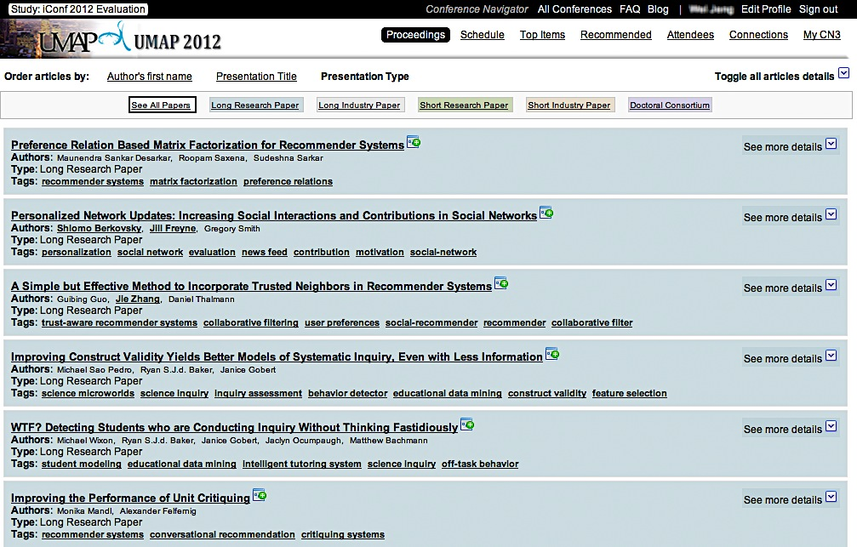
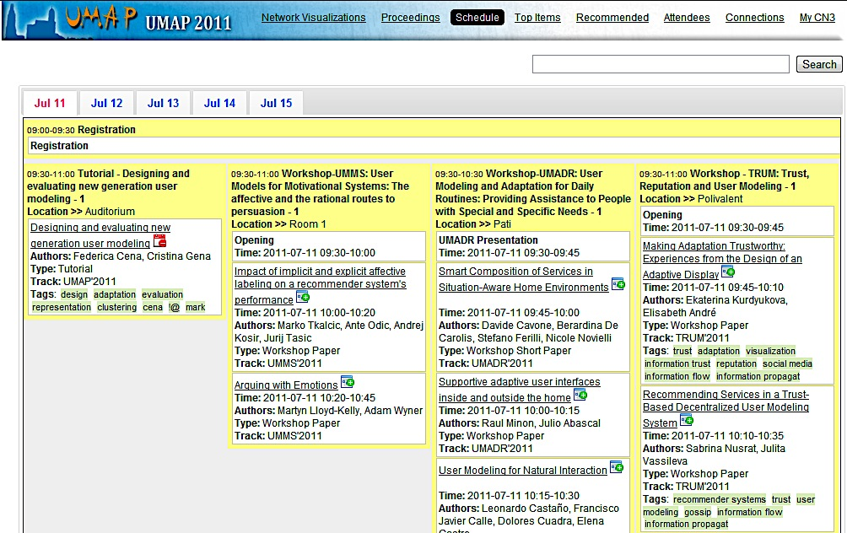
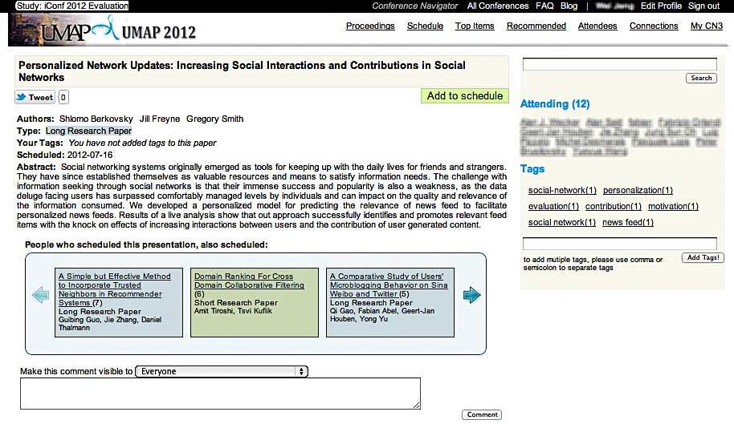
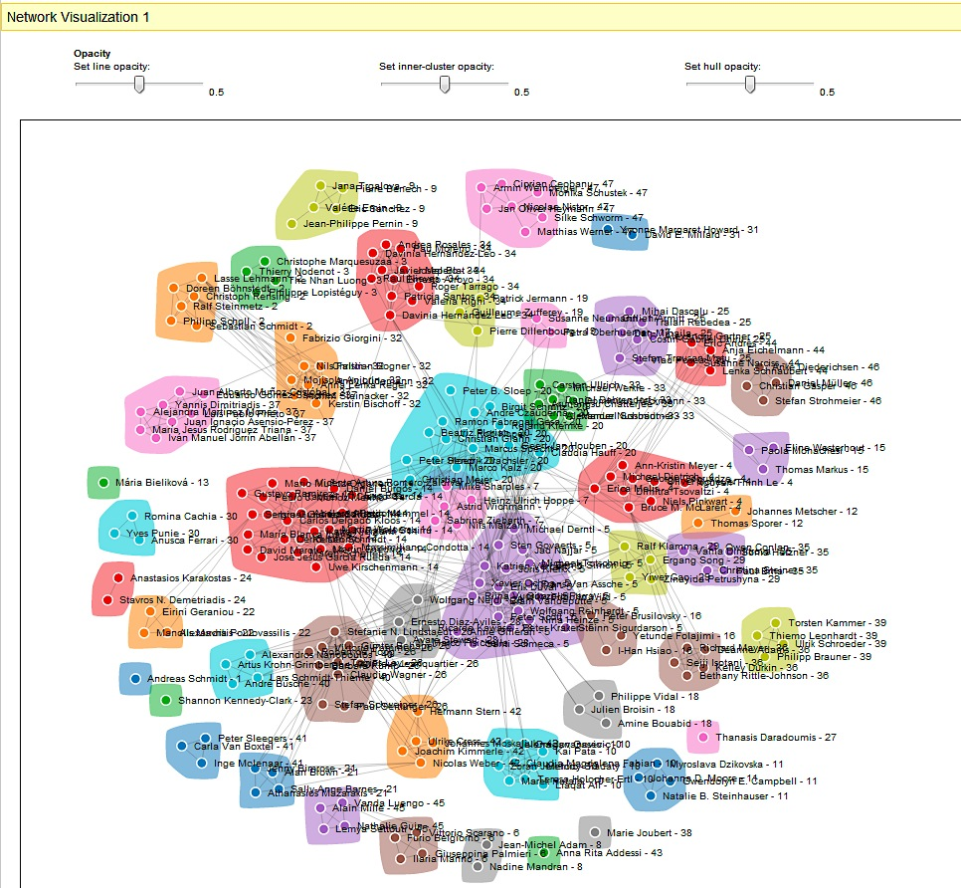
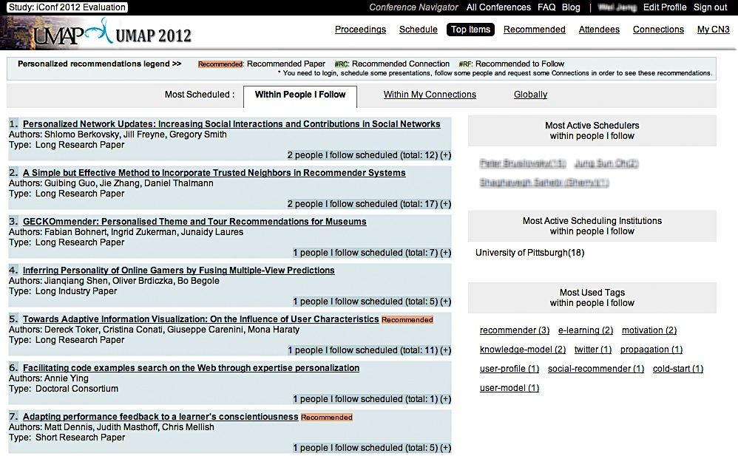
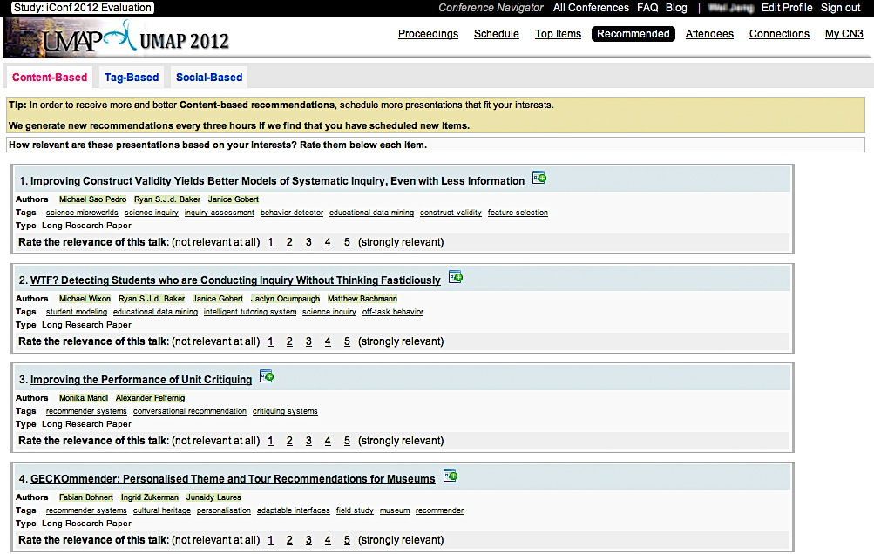
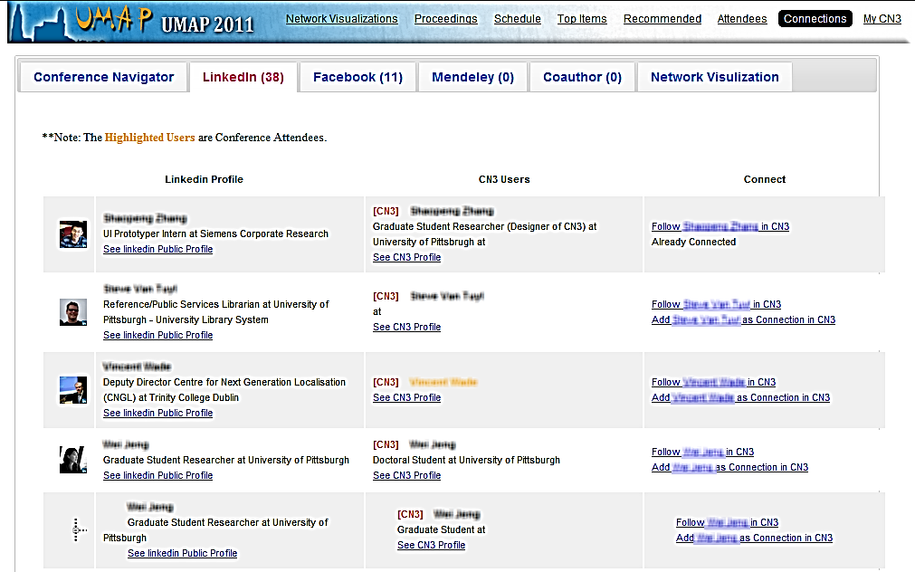
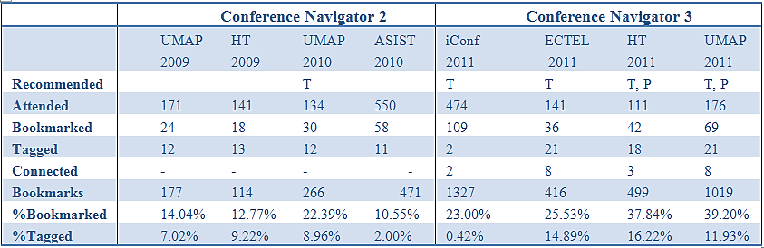
Conference Navigator 3: An Online Social Conference Support System
Denis Parra, Wei Jeng, Peter Brusilovsky, Claudia López, Shaghayegh Sahebi
School of Information Sciences, University of Pittsburgh, Pittsburgh, PA, 15260
{dap89,wej9,peterb,cal95,shs106}@pitt.edu
Most academic conferences feature web-based tools to en-able their attendees to acquire information about conference events and attendees. However, they usually fail to support personalized access to this information. Personalized access may help attendees to find talks and people that fit their research interests, and therefore enhance their academic experience during the conference.
Main Features on Conference Navigator 3
Proceedings This proceedings list displays articles presented during the conference.
Schedule This schedule view is grouped by day and by session, facilitating users’ navigation and filtering of papers that they can attend
Paper Details This detail page shows the details of a paper presented during the conference. The authenticated user can see a list of papers in the widget “People who scheduled X also scheduled Y”.
List of Attendees This provides attendees’ affiliations, web page, and number of scheduled talks during the conference. The list of attendees is shown only to other conference attendees.
Introducing Conference Navigator 3
User’s Profile Page This profile page will display a user's affiliation, contact information, followers, contacts and personal schedule in the conference
This poster presents Conference Navigator 3 (CN3), the system that provides a personalized user experience to conference attendees to achieve critical goals:
finding, scheduling and commenting the most relevant talks during the conference, and
contacting people with similar interests and building a network of research contacts.
Top Items These top item lists show several ranked lists of the most scheduled papers, the most active schedulers or institutions, and the most popular tags.
Recommendations Recommendation pages feature two methods for talk recommendation (content-based and tag-based) and one method for people recommendation.
Connections Connection feature allow users to explore and enhance their contact network by connecting through CN3 and Facebook, LinkedIn, Mendeley or CiteUlike,
Network Visualizations
User Engagement Statistics
Table 1. Usage statistics of CN 2 and CN3 at different confer-ences. Number of users who bookmarked/tagged talks and con-nected to other users in relation to the total number of attendees, and availability of recommendations for talks (T) and people (P)
Summary Future Work
From the table, we can highlight some trends:
a) There is a clear increase in participation from CN2 to CN3 reflected in the percentage of people who bookmarked talks,
b) We incorporated additional tagging mechanisms that led to increased participation after iConf2011
c) The numbers also show a positive relationship between system usage and the availability of recommendations.
Conference Navigator 3 (CN3) has increasingly engaged more researchers in planning their conference activities before and during the conferences. Their activities have already helped conference chairs in creating the conference schedules based on co-scheduling patterns. Additionally, our users receive recommendations for all the conferences that are supported by the system.
Conference Navigator 3 (CN3) will also provide new features at UMAP 2012 to further support networking among users such as the integration with Twitter, a news-feed and support for workshops. Furthermore, our next CN3 version will introduce rich visualizations of recommendations and we will study their effect.
[1] Farzan, R. and P. Brusilovsky (2008). Where did the researchers go?: supporting social navigation at a large academic. Proceedings of the nineteenth ACM conference on Hypertext and Hypermedia. Pittsburgh, PA, USA, ACM: 203-212.
[2] Wongchokprasitti, C., P. Brusilovsky, et al. (2010). Conference Navigator 2.0: Community-Based Recommendation for Academic Conferences. Workshop IUI 2010. Hong Kong, China.
[3] Brusilovsky, P.; Parra, D.; Sahebi, S.; Wongchokprasitti, C.; , "Collaborative information finding in smaller communities: The case of research talks," Collaborative Computing: Networking, Applications and Worksharing (CollaborateCom), 2010 6th International Conference on , vol., no., pp.1-10, 9-12 Oct. 2010

